Slide 1

Gaussian Processes
Separating signal from noise using a Bayesian machine learning approach

Slide 2
Content
Max:
What are GPs on the example of Regression:
Frequentistic approaches <-> Bayesian approach
Was ist GP (Bayesianische Statistik, Propabilistische Modelle, …)
Wofür können wir GPs nutzen?
Timo:
Pipeline

Slide 3
What are Gaussian Processes?
Shown at the example of regression

Slide 4
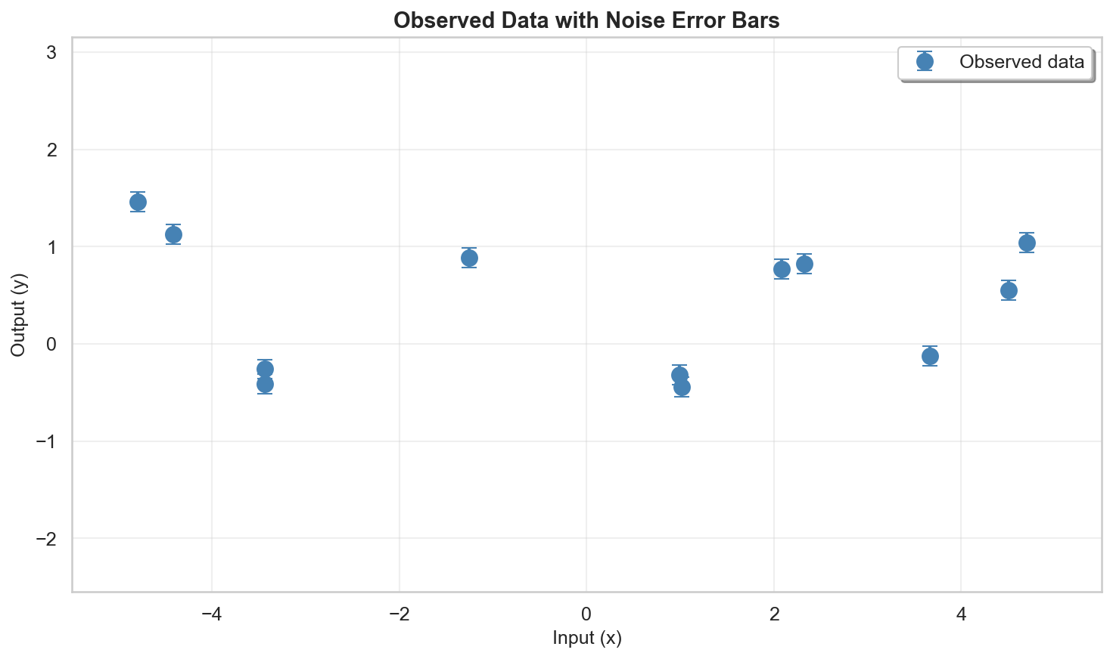
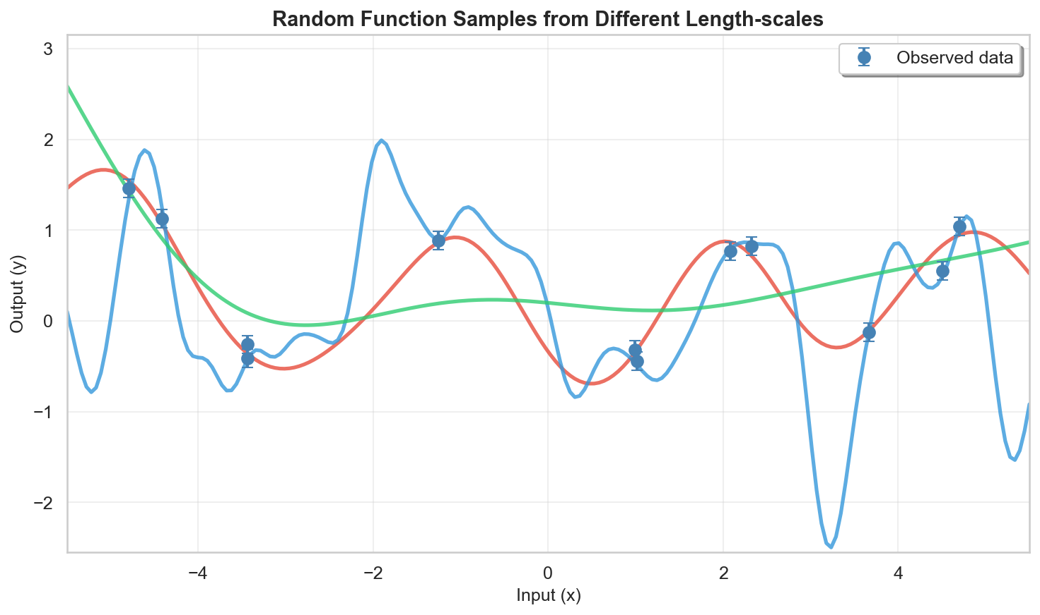
ML -> Supervised Learning -> Regression
Search Input to Output mapping from empirical data
Continuous output mapping: Regression
Problem: “All functions describing the data equally valid (?)”
Notes:
ML: Learn form data
supervised learning: problem of learning input-output mappings from empirical data (the training dataset).
Regression: continuous output mapping (vs. classification)

Slide 5
Supervised Learning (Regression)
Typical approach:
Linear functions only (linear regression)
Polynomial regression
Decision Trees/ Random Forests
Neural Networks
….
Restrict class of functions
Example: Linear regression $f(x)= a1 x + a2$
Notes:
It can happen that the function class is not well suited for my problem

Slide 6

Supervised Learning (Regression)
Typical approach:
Restrict class of functions
Bayesian Approach:
Give a probability to EVERY POSSIBLE function going through the data
In other words:
probability-density-function for functions
0.11%
0.05%
0.02%
Notes:
How do we find a propability for these functions?

Slide 7
Supervised Learning (Regression)
probability-density-function for functions
Notes:
How do we find a propability for these functions?

Slide 8
Supervised Learning (Regression)
Typical approach:
Restrict class of functions
Bayesian Approach:
Give a probability to EVERY POSSIBLE function.
Higher propabilty to functions that are more likely, for example because they are smoother.
Gives probability-density-function for functions
Notes:
It can happen that the function class is not well suited for my problem

Slide 9
Supervised Learning (Regression)
Linear functions only (linear regression)
Polynomial regression
Decision Trees/ Random Forests
Neural Networks
….
Give a propability to EVERY POSSIBLE function. Higher propabilty to functions that are more likely, for example because they are smoother.
Kurzes Beispiel für das Fitten von Daten
Dann Beispiel zum seperieren von zwei Signalen
S = S1(t) + S2(Temp)
Restrict class of functions
bayesian

Slide 10
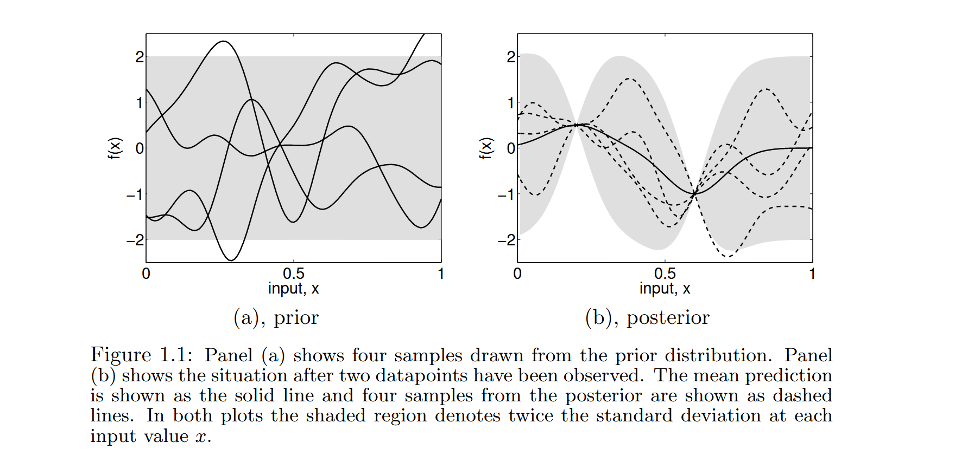
How does Bayesian approach work?
Approach B:
Give a propability to EVERY POSSIBLE function. Higher propabilty to functions that are more likely, for example because they are smoother.
Make a prior:
That means, make mathematically some restrictions, which function is more likely.
You do that by two steps: Mean, Kernel.
For example, in (a): Mean = 0, Kernel = “smooth”. -> assumptions before we see any data
Now add some data (obersvations) (b)
D = {(x1, y1), (x2, y2)}

Slide 11
What are Gaussian Processes (GPs)?
supervised learning, which is the problem of learning input-output mappings from empirical data -> Contineous output: Regression
ML
Learns from data
Random Forest
NN
Linear Regression
GP
Propabilstic Model:
(Prediction + Uncertainty)

Slide 12
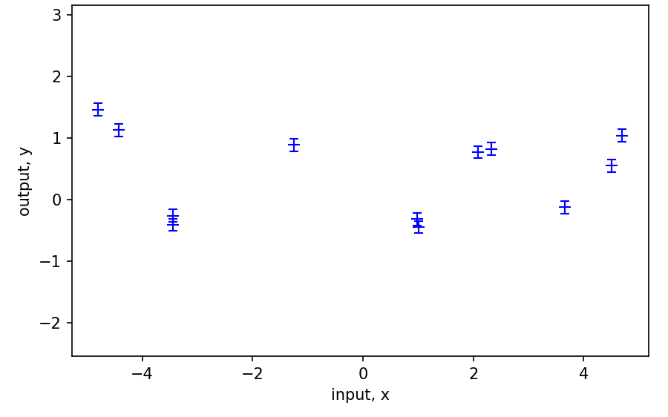
We measure: y = Signal + Noise
We want: f(x) = True underlying curve
DON’T assume a fixed formular (linear, polynomal, …)
WANT most plausible curve from all possible curves
-> A GP is a distribution over curves

Slide 13
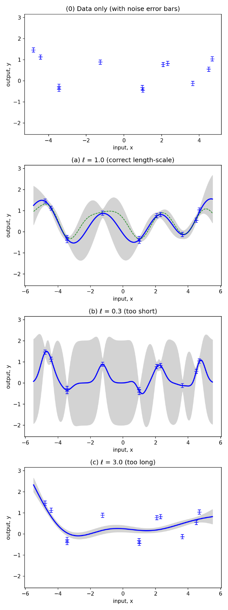
We measure: y = Signal + Noise
We want: x = True underlying curve

Slide 14
When to use a GP?
Put in prior knowledge (kernel)
Small to medium datasets ( ~ 10 – 5000)
Often used for sensor signals

Slide 15
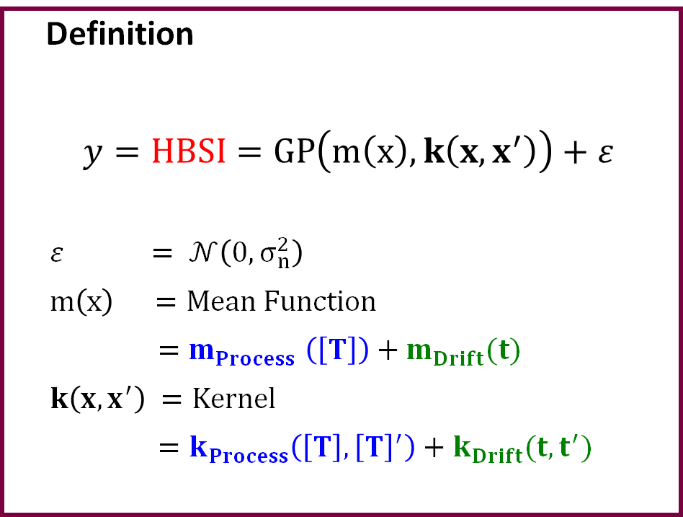
Separation tool: Gaussian Processes (GP)
Benefits with GP
Statistical method
– no training needed
No assumptions on data distribution
Low computational and memory requirements by optimized data selection.
Implementable in a Transmitter
Definition
$y=HBSI=GP\left(m\left(x\right), k\left(x,x^{′}\right)\right)+ε$
$ε = 𝒩\left(0, σ_{n}^{2}\right)$
$m\left(x\right) =Mean Function$
$=m_{Process}$ $\left(\left[T\right]\right)+m_{Drift}(t)$
$k\left(x,x^{′}\right) =Kernel$
$=k_{Process}\left(\left[T\right],{\left[T\right]}^{′}\right)+k_{Drift}(t,t^{′})$
Additive noise

Slide 16
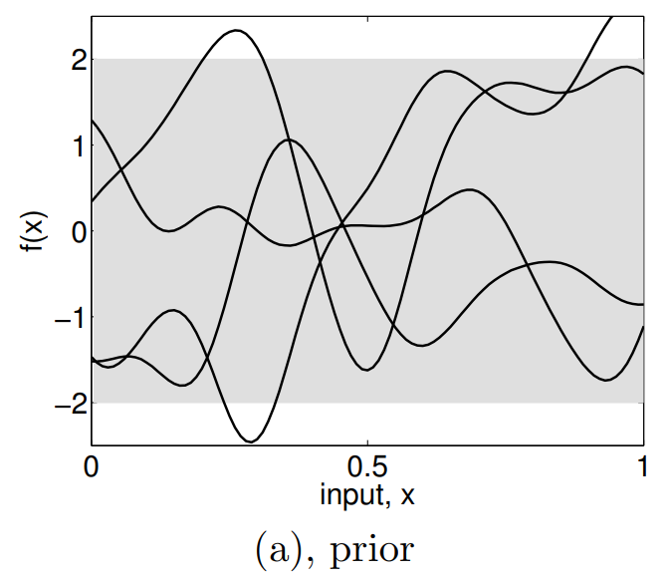






Gaussian Process consists out of three steps
$$m_{Process} \left(\left[T\right]\right)= m_{Drift}\left(t\right)=0$$
$$ℓ$$
Prior Assumption
$$k_{Drift}\left(t,t′\right){=k}_{SE}\left(t,t^{′}\right)= α\exp\left(−\frac{{\left(t−t^{′}\right)}^{2}}{2ℓ^{2}}\right)$$
$ℓ$ influences the period
$$α$$
$α$ influences the amplitude
Given input data (Point 1 – Point N) are calculated into the kernels.
Posterior prediction

Slide 17




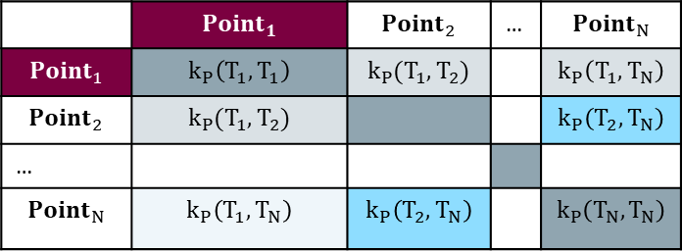


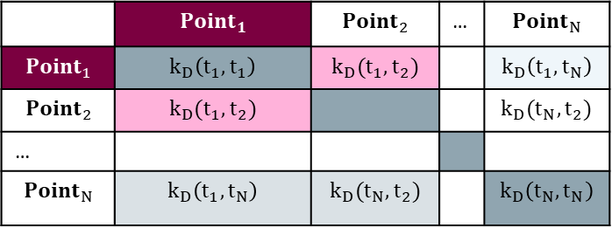




Gaussian Process consists out of three steps
Prior Assumption
$$k_{Drift}\left(t_{i},t_{j}\right) =f(\left|t_{i} −t_{j}\right|)$$
$$Point_{1}(T_{m,1}, T_{c,1}, HBSI_{1}, t_{1})$$
$$k_{Process}(T_{i}, T_{j})=f \left( \right|T_{m,i } −T_{m,j}|+|T_{c,i }−T_{c,j}|)$$
$$K_{Drift}=k_{Drift} ({\left\{t_{i} \right\}}_{i=1}^{N}$$
…
$$T_{m} [°C]$$
 | $${Point}_{1}$$ | $${Point}_{2}$$ | … | $${Point}_{N}$$
$${Point}_{1}$$ | $$k_{D}\left(t_{1}, t_{1}\right)$$ | $$k_{D}(t_{1}, t_{2})$$ |  | $$k_{D}\left(t_{1},t_{N}\right)$$
$${Point}_{2}$$ | $$k_{D}(t_{1}, t_{2})$$ |  |  | $$k_{D}(t_{N},t_{2})$$
…
$${Point}_{N}$$ | $$k_{D}\left(t_{1},t_{N}\right)$$ | $$k_{D}(t_{N},t_{2})$$ |  | $$k_{D}\left(t_{N},t_{N}\right)$$
Given input data (Point 1 – Point N) are calculated into the kernels.
…
$$T_{c} [°C]$$
$$K_{Process}=k_{Process} ({\left\{T_{i} \right\}}_{i=1}^{N}$$
 | $${Point}_{1}$$ | $${Point}_{2}$$ | … | $${Point}_{N}$$
$${Point}_{1}$$ | $$k_{P}\left(T_{1}, T_{1}\right)$$ | $$k_{P}(T_{1}, T_{2})$$ |  | $$k_{P}\left(T_{1},T_{N}\right)$$
$${Point}_{2}$$ | $$k_{P}(T_{1}, T_{2})$$ |  |  | $$k_{P}\left(T_{2},T_{N}\right)$$
…
$${Point}_{N}$$ | $$k_{P}\left(T_{1},T_{N}\right)$$ | $$k_{P}\left(T_{2},T_{N}\right)$$ |  | $$k_{P}\left(T_{N},T_{N}\right)$$
…
Posterior prediction
$$HBSI [\%]$$
$$t_{1}$$
$$t_{2}$$
…
$$t_{N}$$

Slide 18
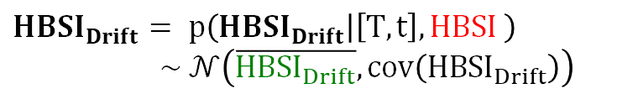



Gaussian Process consists out of three steps
Prior Assumption
$$k_{Drift}\left(t,t′\right) =f(\left|t_{i} −t_{j}\right|)$$
$$Point_{1}(T_{m,1}, T_{c,1}, HBSI_{1}, t_{1})$$
$$k_{process}(T_{i}, T_{j})=f \left( \right|T_{m,i } −T_{m,j}|+|T_{c,i }−T_{c,j}|)$$
…
$$T_{m} [°C]$$
$$K_{drift}=k_{drift} ({\left\{t_{i},t_{j} \right\}}_{i,j=1}^{N}$$
Given input data (Point 1 – Point N) are calculated into the kernels.
$$K_{process}=k_{process} ({\left\{T_{i},T_{j}\right\}}_{i,j=1}^{N}$$
…
$$T_{c} [°C]$$
$HBSI_{Drift}= p\left(HBSI_{Drift} | \left[T,t\right],HBSI \right)$ $\sim 𝒩\left(\overline{HBSI_{Drift}}, cov\left(HBSI_{Drift}\right)\right)$
…
Posterior prediction
$$HBSI [\%]$$
$$HBSI_{Drift}=K_{Drift}{ \left(K_{Drift}+K_{Process}+σ^{2}I\right)}^{−1}HBSI$$
$$C_{Drift} = K_{Drift}−K_{Drift}{(K_{Drift}+ K_{Process}+σ^{2}I)}^{−1}K_{Drift}$$
…
$$t_{1}$$
$$t_{2}$$
$$t_{N}$$

Slide 19
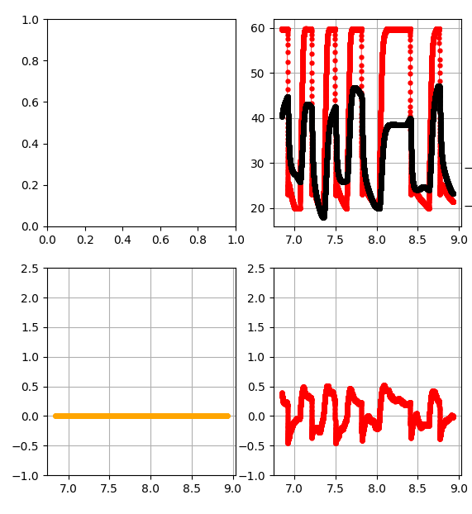
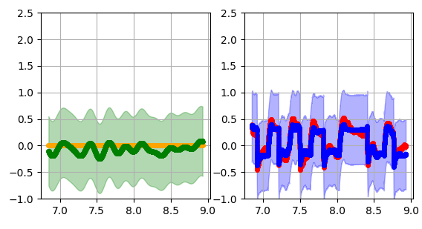
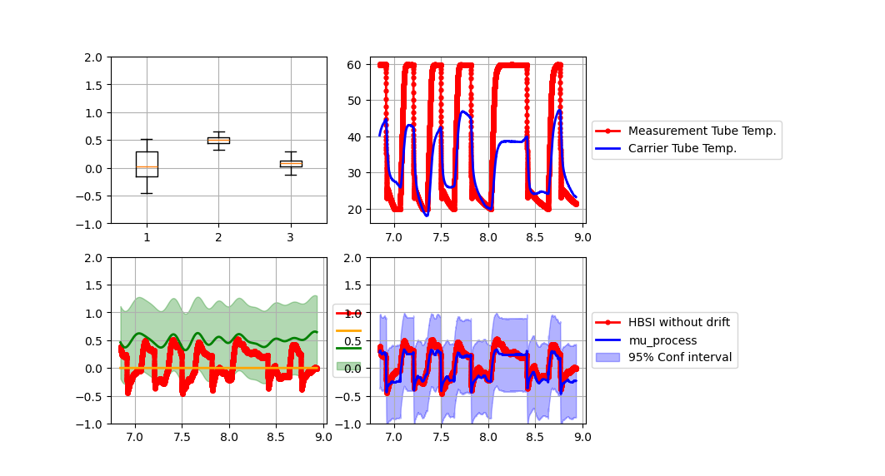
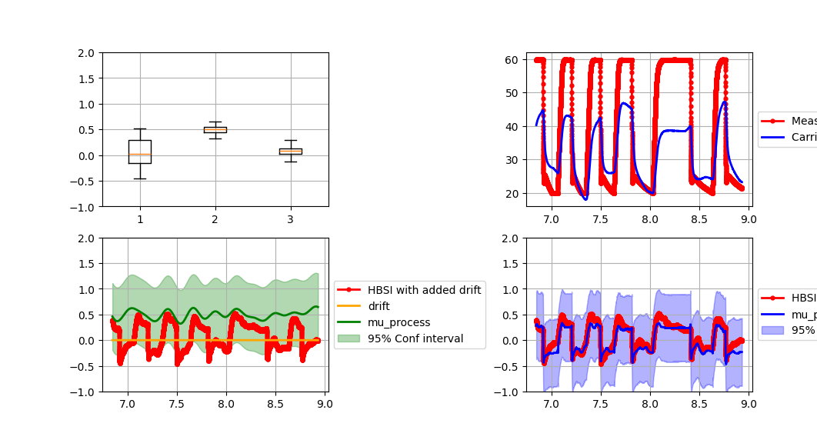
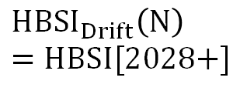

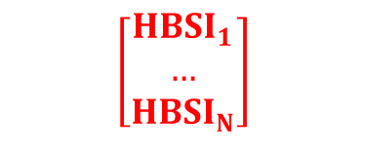
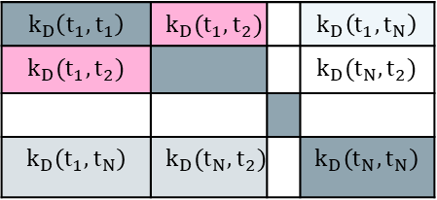


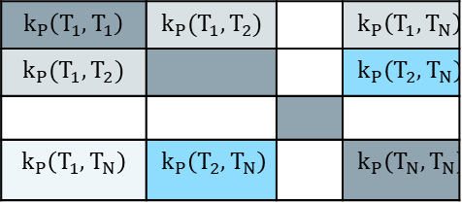



HBSI[2028+] is the last value in the $HBSI_{Drift}$ vector
HBSI (2021)
$$HBSI_{Process}(T_{medium}, T_{carrier tube})$$
$$HBSI_{Drift}(t)$$
HBSI [%]
$$=$$
$$+$$
$$HBSI_{Drift}\left(N\right) \\ =HBSI[2028+]$$
Data Point [#] – sampling freq = 3 s
Data Point [#] – sampling freq = 3 s
Data Point [#] – sampling freq = 3 s
$$HBSI_{drift}\left(N\right)=K_{Drift}[N,:]{ \left(K_{Drift}+K_{Process}+σ^{2}I\right)}^{−1} HBSI$$
$HBSI \left[2028+\right]$ (t)
$${\left( + + σ^{2}I\right)}^{−1}$$
$$k_{D}\left(t_{1},t_{N}\right)$$ | .. | $$k_{D}\left(t_{N},t_{N}\right)$$
$$k_{D}\left(t_{1}, t_{1}\right)$$ | $$k_{D}(t_{1}, t_{2})$$ |  | $$k_{D}\left(t_{1},t_{N}\right)$$
$$k_{D}(t_{1}, t_{2})$$ |  |  | $$k_{D}(t_{N},t_{2})$$
$$k_{D}\left(t_{1},t_{N}\right)$$ | $$k_{D}(t_{N},t_{2})$$ |  | $$k_{D}\left(t_{N},t_{N}\right)$$
$$k_{P}\left(T_{1}, T_{1}\right)$$ | $$k_{P}(T_{1}, T_{2})$$ |  | $$k_{P}\left(T_{1},T_{N}\right)$$
$$k_{P}(T_{1}, T_{2})$$ |  |  | $$k_{P}\left(T_{2},T_{N}\right)$$
$$k_{P}\left(T_{1},T_{N}\right)$$ | $$k_{P}\left(T_{2},T_{N}\right)$$ |  | $$k_{P}\left(T_{N},T_{N}\right)$$
$$\left[\begin{matrix}HBSI_{1} \\ … \\ HBSI_{N}\end{matrix}\right]$$

Slide 20
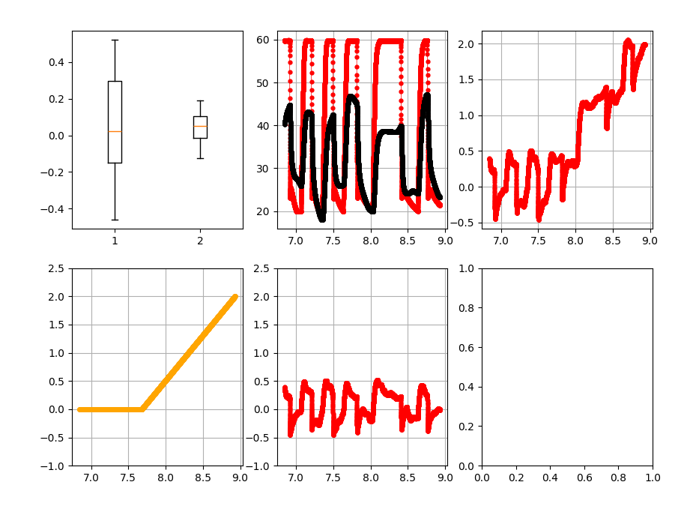
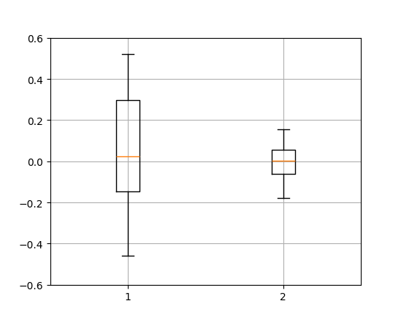
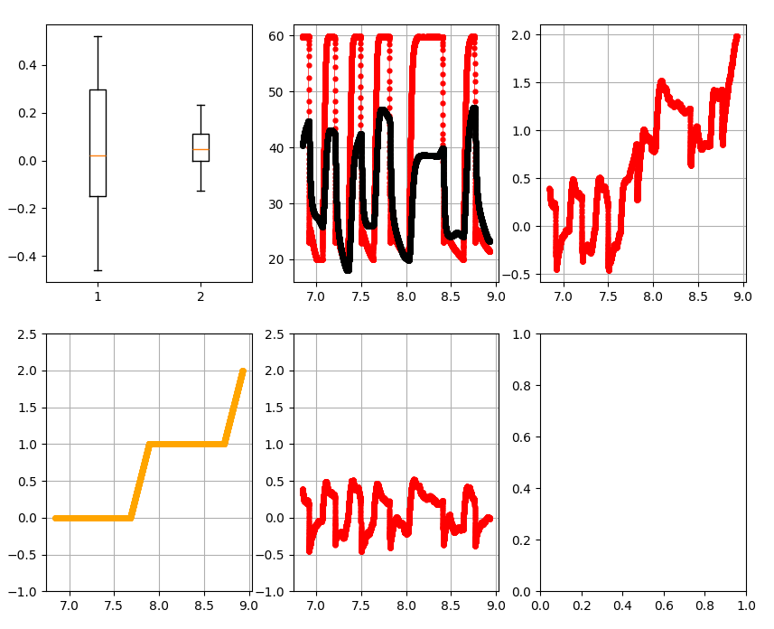
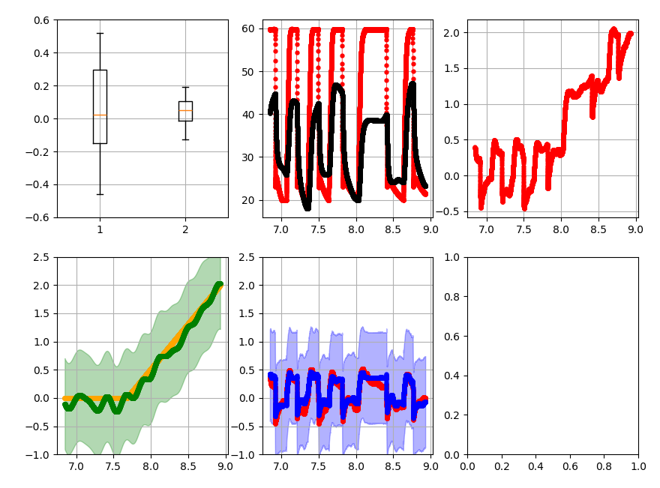
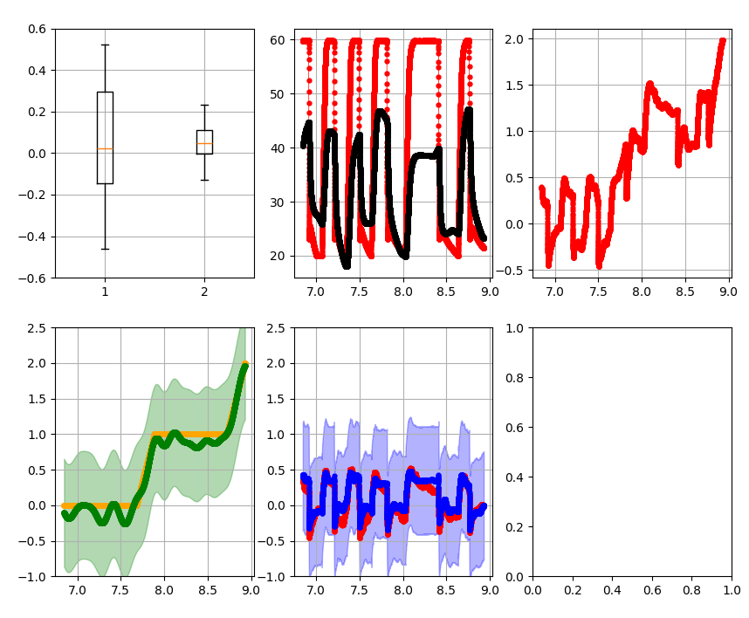






Gaussian Process Concept on HBSI[2021] with drift
HBSI (2021)
$$HBSI_{process}(T_{m}, T_{c})$$
$$HBSI_{drift}(t)$$
Performance: diff( , )
HBSI [%]
$$=$$
$$+$$
$$+$$
HBSI [%]
$$=$$
$$+$$
$$+$$
Data Point [#] – sampling freq = 3 s
Data Point [#] – sampling freq = 3 s
Data Point [#] – sampling freq = 3 s

Slide 21
Python Pipeline

Slide 22


Pipeline Goals
Simplicity: Simple to understand, expand, and use
Extendibility
Test Automation
Result Aggregation
Tooling:

Slide 23
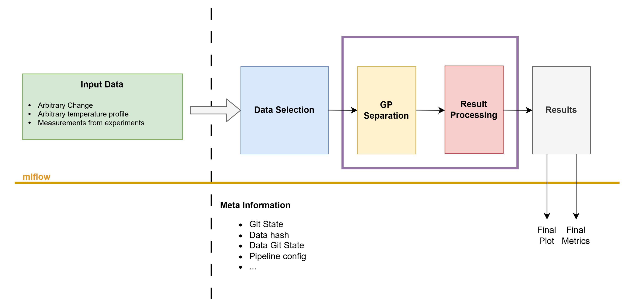
Pipeline
Repeat for each selection

Slide 24
Pipeline
Repeat for each selection
Synthetic Data Generator

Slide 25
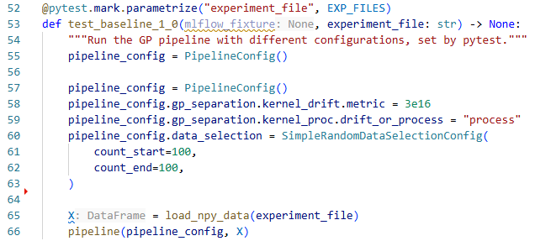
Test Case Definition

Slide 26
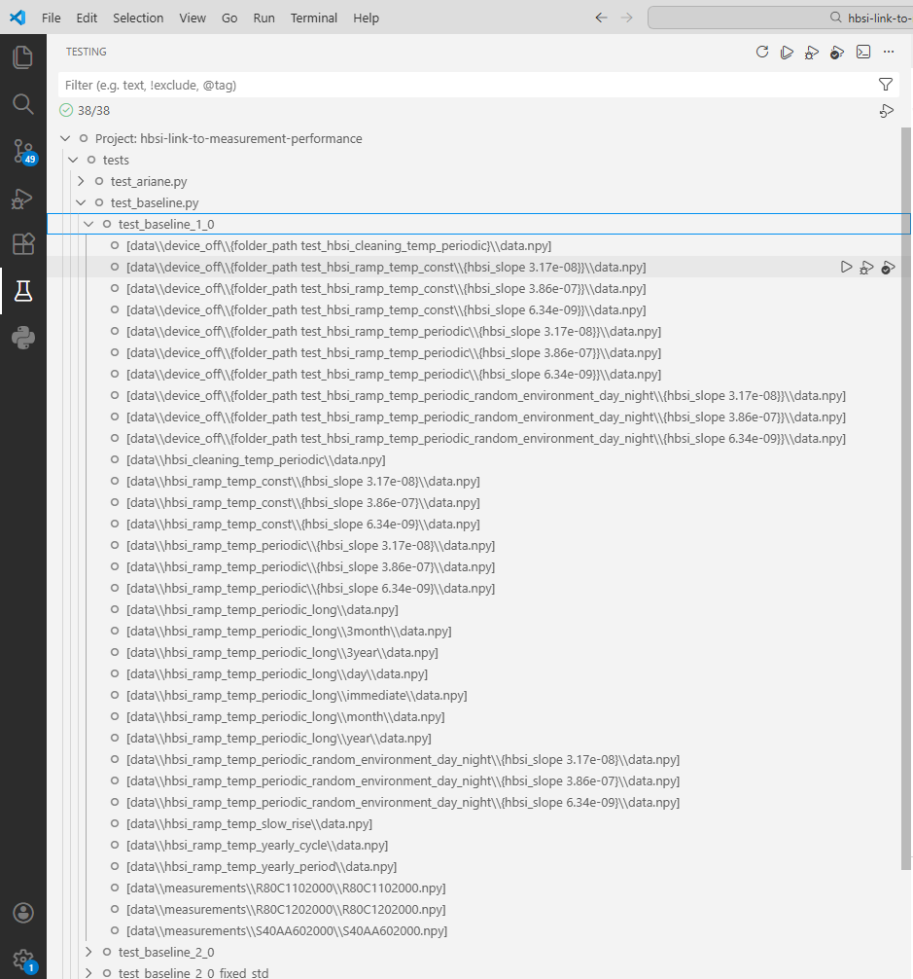
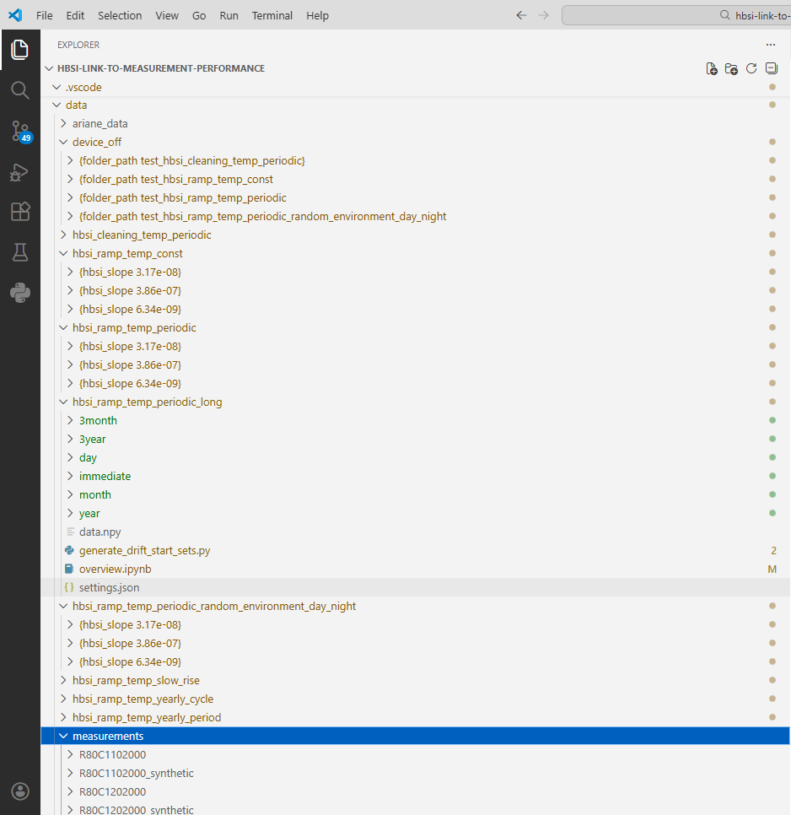
Test Case Definition

Slide 27
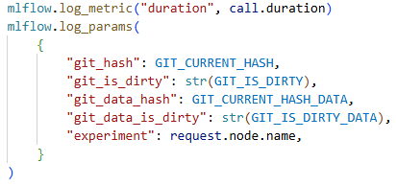
Logging with MLFlow
Run information
Plots
Files
Dataset, metrics, …

Slide 28
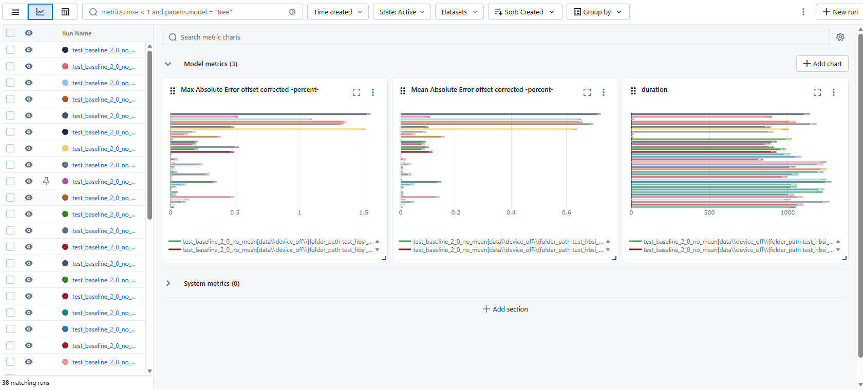
Compare KPIs between Runs

Slide 29
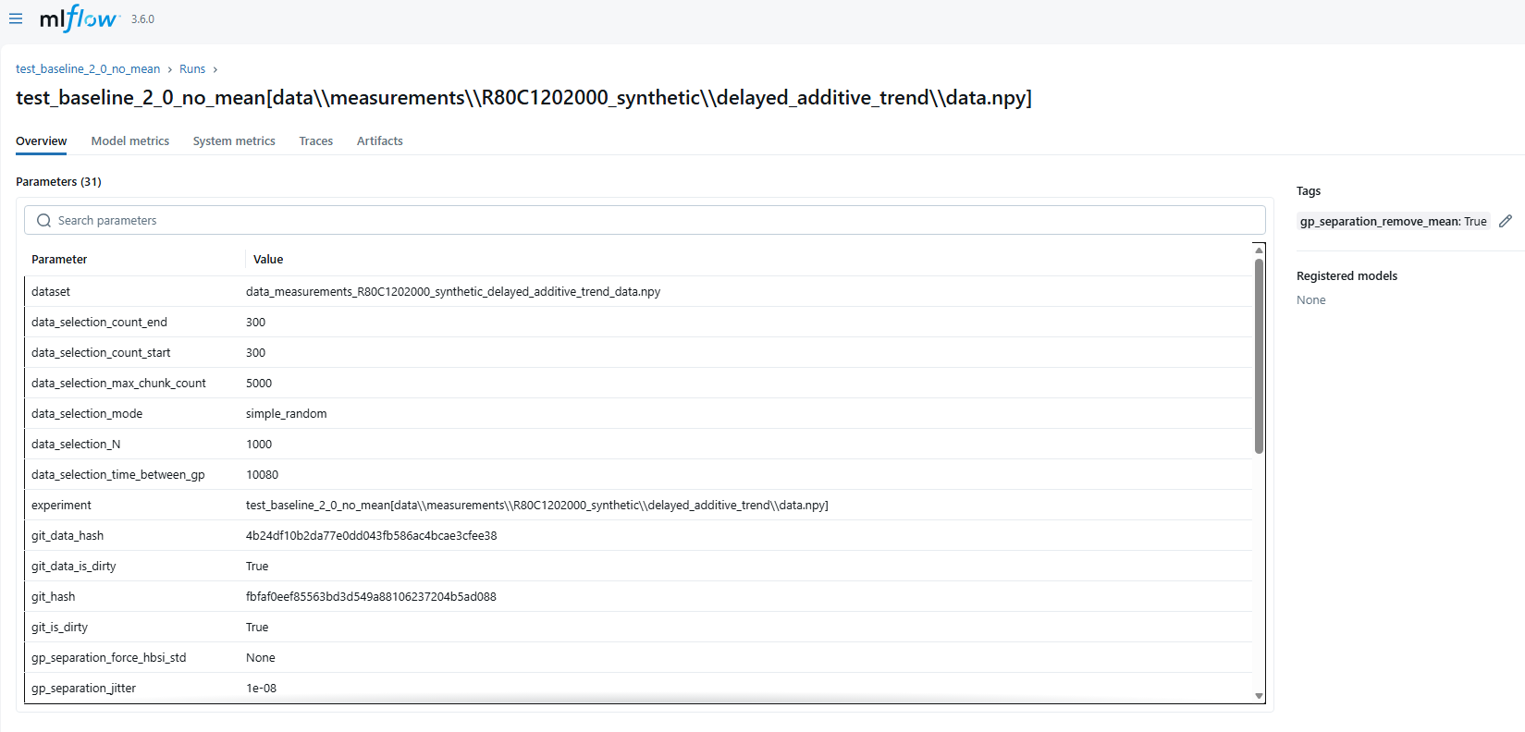
Compare KPIs between Runs

Slide 30
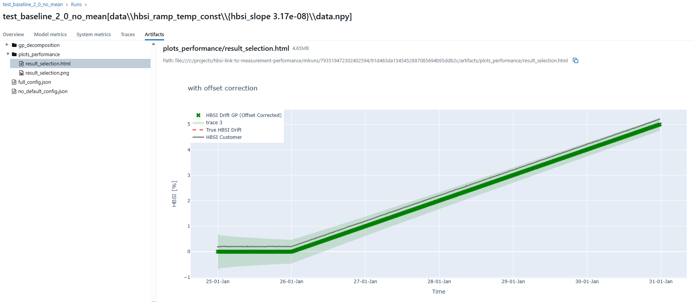
Compare KPIs between Runs

